Slide 1


Slide 2
Chapter 15
Materials Requirements Planning

Slide 3
OBJECTIVES
Material Requirements Planning (MRP)
MRP Logic and Product Structure Trees
Time Fences
MRP Example
MRP II and Lot Sizing
Notes:
2
2

Slide 4
Material Requirements Planning
Defined
Materials requirements planning (MRP) is a means for determining the number of parts, components, and materials needed to produce a product
MRP provides time scheduling information specifying when each of the materials, parts, and components should be ordered or produced
Dependent demand drives MRP
MRP is a software system
Notes:
3
3

Slide 5
Example of MRP Logic and Product Structure Tree
Given the product structure tree for “A” and the lead time and demand information below, provide a materials requirements plan that defines the number of units of each component and when they will be needed
Product Structure Tree for Assembly A
Lead Times
A 1 day
B 2 days
C 1 day
D 3 days
E 4 days
F 1 day
A
B(4)
C(2)
Total Unit Demand
Day 10 50 A
Day 8 20 B (Spares)
Day 6 15 D (Spares)
D(2)
E(1)
D(3)
F(2)
Notes:
4
4

Slide 6
First, the number of units of “A” are scheduled backwards to allow for their lead time. So, in the materials requirement plan below, we have to place an order for 50 units of “A” on the 9th day to receive them on day 10.
LT = 1 day
Notes:
5
5

Slide 7
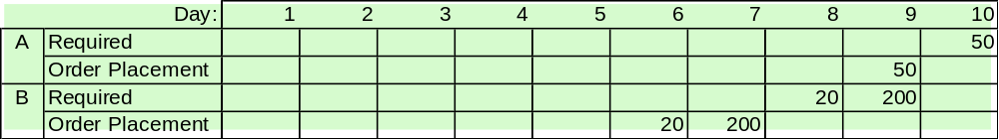

Next, we need to start scheduling the components that make up “A”. In the case of component “B” we need 4 B’s for each A. Since we need 50 A’s, that means 200 B’s. And again, we back the schedule up for the necessary 2 days of lead time.
LT = 2
Spares
A
4x50=200
B(4)
C(2)
D(2)
E(1)
D(3)
F(2)
Notes:
6
6

Slide 8
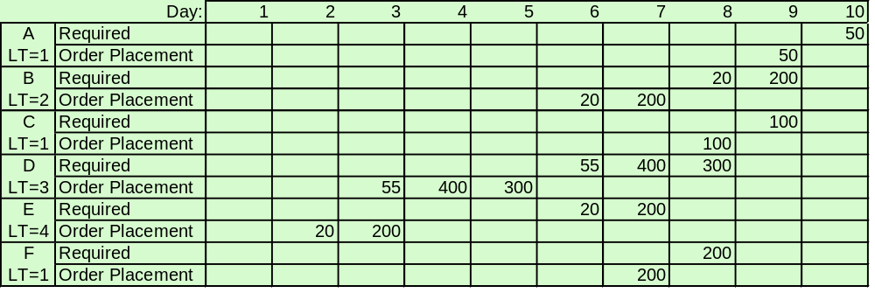
Finally, repeating the process for all components, we have the final materials requirements plan:
A
Part D: Day 6
B(4)
C(2)
40 + 15 spares
D(2)
E(1)
D(3)
F(2)
The McGraw-Hill Companies, Inc., 2001
Notes:
7
7

Slide 9
Master Production Schedule (MPS)
Time-phased plan specifying how many and when the firm plans to build each end item
Aggregate Plan
(Product Groups)
MPS
(Specific End Items)
Notes:
8
8

Slide 10
Types of Time Fences
Frozen
  No schedule changes allowed within this window
Moderately Firm
  Specific changes allowed within product groups as long as parts are available
Flexible
  Significant variation allowed as long as overall capacity requirements remain at the same levels
Notes:
9
9

Slide 11
Example of Time Fences
Exhibit 15.5
Moderately
Firm
Frozen
Flexible
Capacity
Forecast and available
capacity
Firm Customer Orders
8
15
26
Weeks
Notes:
10
10

Slide 12
Material Requirements Planning System
Based on a master production schedule, a material requirements planning system:
  Creates schedules identifying the specific parts and materials required to produce end items
  Determines exact unit numbers needed
  Determines the dates when orders for those materials should be released, based on lead times
Notes:
11
11

Slide 13
Firm orders
from known
customers
Aggregate
product
plan
Forecasts
of demand
from random
customers
Engineering
design
changes
Inventory
transactions
Master production
Schedule (MPS)
From Exhibit 15.6
Material
planning
(MRP
computer
program)
Bill of
material
file
Inventory
record file
Secondary reports
Primary reports
Exception reports
Planning reports
Reports for performance control
Planned order schedule for inventory and production control
The McGraw-Hill Companies, Inc., 2004
Notes:
12
12

Slide 14
Bill of Materials (BOM) File
A Complete Product Description
Materials
Parts
Components
Production sequence
Modular BOM
  Subassemblies
Super BOM
  Fractional options
Notes:
13
13

Slide 15
Inventory Records File
Each inventory item carried as a separate file
  Status according to “time buckets”
Pegging
  Identify each parent item that created demand
Notes:
14
14

Slide 16
Primary MRP Reports
Planned orders to be released at a future time
Order release notices to execute the planned orders
Changes in due dates of open orders due to rescheduling
Cancellations or suspensions of open orders due to cancellation or suspension of orders on the master production schedule
Inventory status data
Notes:
15
15

Slide 17
Secondary MRP Reports
Planning reports, for example, forecasting inventory requirements over a period of time
Performance reports used to determine agreement between actual and programmed usage and costs
Exception reports used to point out serious discrepancies, such as late or overdue orders
Notes:
15
15

Slide 18
Additional MRP Scheduling Terminology
Gross Requirements
Scheduled receipts
Projected available balance
Net requirements
Planned order receipt
Planned order release
Notes:
19
19

Slide 19
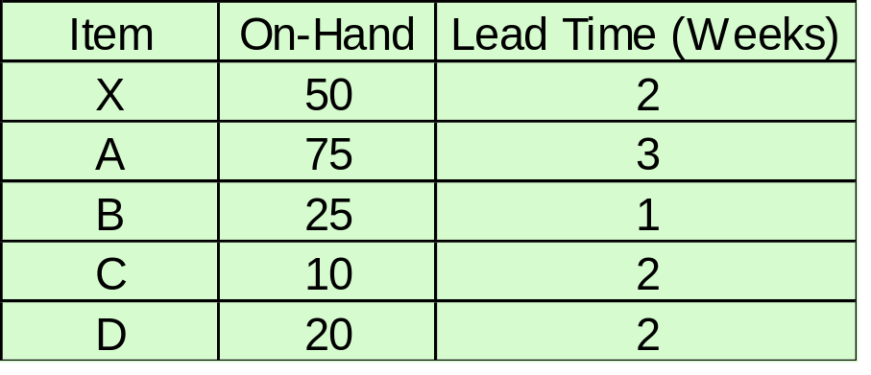
MRP Example
X
A(2)
B(1)
C(3)
C(2)
D(5)
Requirements include 95 units (80 firm orders and 15 forecast) of X in week 10
Notes:
18
18

Slide 20
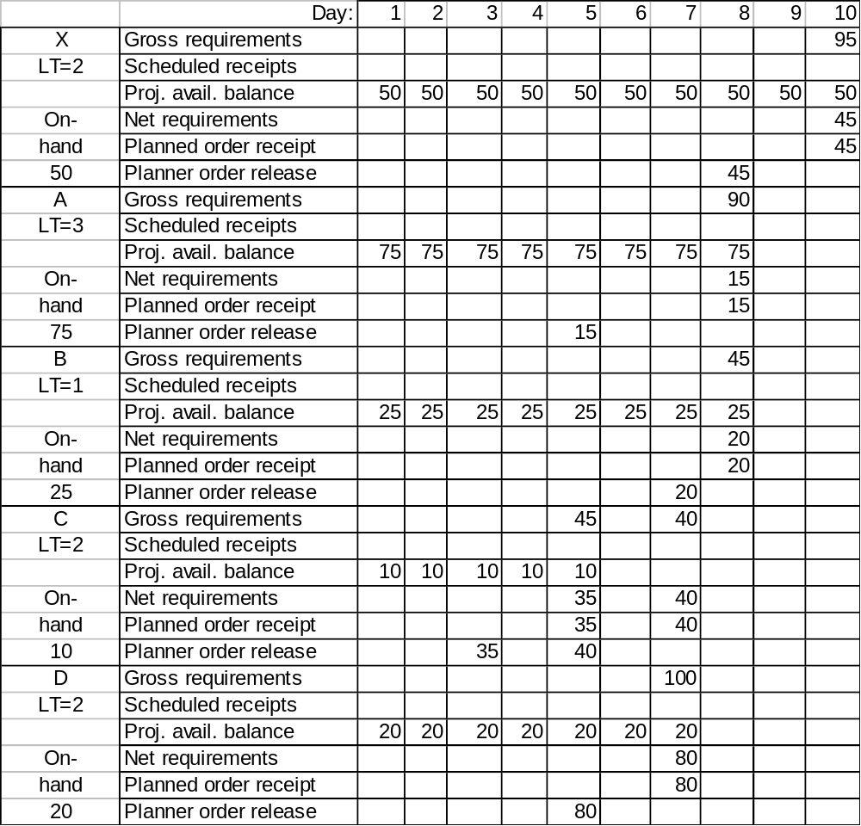
X
A(2)
It takes 2 A’s for each X
Notes:
21
21

Slide 21
X
A(2)
B(1)
It takes 1 B for each X
Notes:
21
21

Slide 22
X
A(2)
B(1)
C(3)
It takes 3 C’s for each A
Notes:
21
21

Slide 23
X
A(2)
B(1)
C(3)
C(2)
It takes 2 C’s for each B
Notes:
21
21

Slide 24
X
A(2)
B(1)
C(3)
C(2)
D(5)
It takes 5 D’s for each B
Notes:
21
21

Slide 25
Closed Loop MRP
Production Planning
Master Production Scheduling
Material Requirements Planning
Capacity Requirements Planning
No
Realistic?
Feedback
Feedback
Yes
Execute:
Capacity Plans
Material Plans
Notes:
22
22

Slide 26
Manufacturing Resource Planning
(MRP II)
Goal: Plan and monitor all resources of a manufacturing firm (closed loop):
  manufacturing
  marketing
  finance
  engineering
Simulate the manufacturing system
Notes:
23
23

Slide 27
Lot Sizing in MRP Programs
Lot-for-lot (L4L)
Economic order quantity (EOQ)
Least total cost (LTC)
Least unit cost (LUC)
Which one to use?
  The one that is least costly!
Notes:
23
23

Slide 28
End of Chapter 15

